Slide 1
COMPLEMENT SYSTEM
Dr. Sandeep Kumar Sharma, BVSc & AH, MVSc and PhD
Assistant Professor, PGIVER
drsharmask01@hotmail.com
Mob. 9414775879

Slide 2
INTRODUCTION
The complement system is a part of the immune system, consists of a series of proteins that interact with one another in a highly regulated (cascade) manner, in order to eliminate pathogens.
It helps antibodies and phagocytic cells to clear pathogens and damaged cells; promote inflammation and attack pathogen’s plasma membrane.
Complements are soluble glycoproteins mostly produced by hepatocytes.

Slide 3
Proteins that take part in the complement system are called complements that collectively work as a biological cascade; the sequence of reactions, each being the catalyst for the next.
Jules Bordet (1895) identified complements as heat-sensitive components in the blood, bearing non-specific antimicrobial activity.
Paul Ehrlich in Berlin independently carried out similar experiments and coined the term complement, defining it as “the activity of blood serum that completes the action of antibody.” In ensuing years, researchers discovered that the action of complement was the result of interactions of a large and complex group of proteins.

Slide 4
More than 34 types of complements are present in serum, found circulating normally in human body in inactive forms (called as zymogens or proenzymes).
Complement activation is triggered by an antibody when it is bound to the antigen.
It can also be triggered by some components of innate immunity. Thus the complement system works in both innate and acquired immunity.
Complements are activated only during inflammatory reactions. During the inflammation, more amount of complements reaches to the interstitial area of the infected tissue through dilated blood vessels, which are then activated by proteolytic cleavage; this exposes the active site of the complements.

Slide 5
Nomenclature
A particular pattern of naming is followed for the components.
Complement components are designated by numerals (C1–C9), by letter symbols (e.g., factor D), or by trivial names (e.g., homologous restriction factor).
Peptide fragments formed by activation of a component are denoted by small letters. In most cases, the smaller fragment resulting from cleavage of a component is designated “a” and the larger fragment designated “b” (e.g., C3a, C3b; but C2 is an exception: C2a is the larger and C2b is smaller cleavage fragment)

Slide 6
Activated components or complexes have a bar over them to indicate activation (eg, C1, C1r, C3bBb). Cleavage fragments are designated with a small letter after the component (eg, C3a and C3b are fragments of C3).
Inactive C3b is designated iC3b.
Cell membrane receptors for C3 are abbreviated CR1, CR2, CR3, and CR4.

Slide 7
The larger fragments bind to the target near the site of activation, and the smaller fragments diffuse from the site and can initiate localized inflammatory responses by binding to specific receptors.
The complement fragments interact with one another to form functional complexes.
Those complexes that have enzymatic activity are designated by a bar over the number or symbol (e.g., C4b2a, C3bBb)

Slide 8
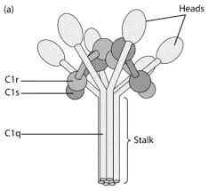
Structure of the C1 macromolecular complex
C1q molecule consists of 18 polypeptide chains arranged into six triplets, each of which contains one A, one B, and one C chain.
Each C1r and C1s monomer contains a catalytic domain with enzymatic activity and an interaction domain that facilitates binding with C1q or with each other.
Electron micrograph of C1q molecule showing stalk and six globular heads.

Slide 9
C1 in serum is a macromolecular complex consisting of C1q and two molecules each of C1r and C1s, held together in a complex (C1qr₂s₂ ) stabilized by Ca²⁺ions.
The C1q molecule is composed of 18 polypeptide chains that associate to form six collagen-like triple helical arms, the tips of which bind to exposed C1q-binding sites in the C_{H}2 domain of the antibody molecule
Each C1r and C1s monomer contains a catalytic domain and an interaction domain; the latter facilitates interaction with C1q or with each other.
Each C1 molecule must bind by its C1q globular heads to at least two Fc sites for a stable C1-antibody interaction to occur.

Slide 10
When pentameric IgM is bound to antigen on a target surface it assumes the so-called “staple” configuration, in which at least three binding sites for C1q are exposed.
Circulating IgM, however, exists as a planar configuration in which the C1q-binding sites are not exposed and therefore cannot activate the complement cascade.
An IgG molecule, on the other hand, contains only a single C1q-binding site in the C_{H}2 domain of the Fc, so that firm C1q binding is achieved only when two IgG molecules are within 30–40 nm of each other on a target surface or in a complex providing two attachment sites for C1q.

Slide 11
Pathways of complement system
The three pathways of complement activation are
  Classical pathway,
  Alternative pathway and
  Mannan Binding Lectin (MBL) pathway
All these pathways end in a common final pathway called the terminal pathway, or the Membrane Attack Complex (MAC).
The MAC is responsible for the lysis of extracellular pathogen by forming pores in microorganism’s membrane.

Slide 12
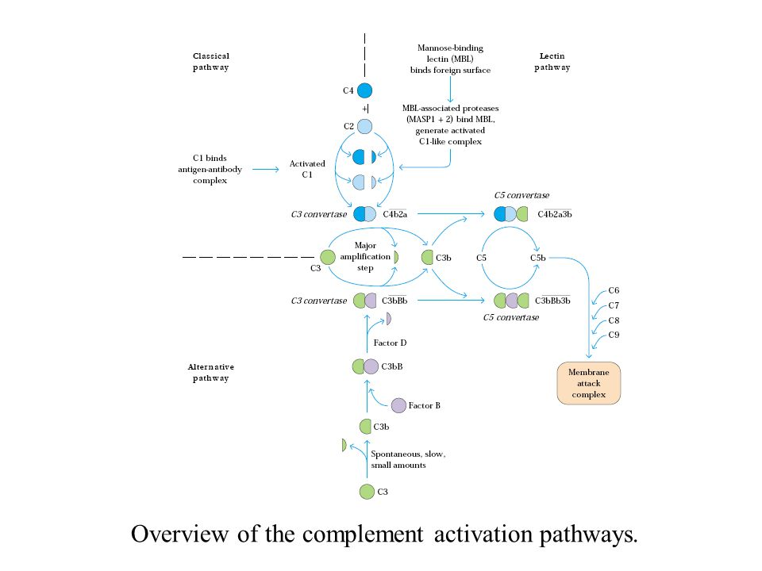
Overview of the complement activation pathways

Slide 13
The classical pathway is initiated when C1 binds to antigen-antibody complexes.
The alternative pathway is initiated by binding of spontaneously generated C3b to activating surfaces such as microbial cell walls.
The lectin pathway is initiated by binding of the serum protein MBL to the surface of a pathogen.
All three pathways generate C3 and C5 convertases and bound C5b, which is converted into a membrane-attack complex (MAC) by a common sequence of terminal reactions.
Hydrolysis of C3 is the major amplification step in all pathways, generating large amounts of C3b, which forms part of C5 convertase. C3b also can diffuse away from the activating surface and bind to immune complexes or foreign cell surfaces, where it functions as an opsonin.

Slide 14
1.Classical pathway:
Components of the Classical Pathway
Native component | Active Component (s) | Function(s)
C1(q,r,s) | C1q | Binds to antibody that has bound antigen, activates C1r.
 | C1r | Cleaves C1s to activate protease function.
 | C1s | Cleaves C2 and C4.
C2 | C2a | Active enzyme Large fragment.
 | C2b | Small part enzyme of classical pathway; cleaves C3 and C5.
C3 | C3a | Mediates inflammation; anaphylatoxin.
 | C3b | Binds C5 for cleavage by C2b. Binds cell surfaces for opsonization and activation of alternate pathway.
C4 | C4a | Mediates inflammation.
 | C4b | Binds C2 for cleavage by C1s. Binds cell surfaces for opsonization.

Slide 15
Classical pathway:
Classical pathway of complement activation is initiated by the binding of IgG (IgG1, IgG2 or IgG3) or IgM to antigen.
After antibody binds to antigen, conformational changes occur in constant region of the antibody, allowing C1q to bind (C1q binds to a single IgM molecule or aggregated IgG).
C1 is a pentameric molecular complex consisting of a single C1q, two C1r and two C1s peptides.
The classical pathway can also be activated by mechanisms independent of Ab. Heparin (a polyanionic anticoagulant) and protamine (a polycation that is used to block heparin), when present in equimolar concentrations, can activate the classical pathway. Various other polyanions (eg, DNA and RNA) are thought to be able to react directly with C1q to activate the classical pathway.

Slide 16
Binding of C1q to Fc binding sites induces a conformational change in C1r that converts C1r to an active serine protease enzyme, C1r, which then cleaves C1s to a similar active enzyme, C1s. C1s has two substrates, C4 and C2.
Activated C1s cleaves C4 into two fragments, C4a (soluble, weak anaphylotoxin) and C4b (bound to cell surface, opsonin).
The C4b fragment attaches to the target surface in the vicinity of C1, and the C2 proenzyme then attaches to the exposed binding site on C4b, where the C2 is then cleaved by the neighboring C1s: the smaller fragment (C2b) diffuses away.
The resulting C4b2a complex is called C3 convertase, referring to its role in converting the C3 into an active form.
The smaller fragment from C4 cleavage, C4a, is an anaphylatoxin, or mediator of inflammation, which does not participate directly in the complement cascade

Slide 17
The native C3 component consists of two polypeptide chains, α and β. Hydrolysis of a short fragment (C3a) from the amino terminus of the α chain by the C3 convertase generates C3b
A single C3 convertase molecule can generate over 200 molecules of C3b, resulting in tremendous amplification at this step of the sequence.
Some of the C3b binds to C4b2a to form a trimolecular complex C4b2a3b, called C5 convertase.
The C3b component of this complex binds C5 and alters its conformation, so that the C4b2a component can cleave C5 into C5a, which diffuses away, and C5b, which attaches to C6 and initiates formation of the membrane attack complex in a sequence described later.

Slide 18
Steps in classical pathway:
Binding of C1 to antibody causes a conformation change in C1q. This results in the activation C1r that then activates C1s.
Activated C1s cleaves C4 into two fragments, C4a (soluble, weak anaphylotoxin) and C4b (bound to cell surface, opsonin).
C4b binds C2. C2 is cleaved by activated C1s to form C2b (remains bound to C4b) and C2a (soluble).

Slide 19
4. C4b2a is the classical pathway C3 convertase. C3 convertase (C4b2a) cleaves C3 into C3a (soluble, anaphylotoxin) and C3b. C3b either binds to membrane or remains bound to C3 convertase (C4b2b) resulting in formation of C5 convertase (C4b2a3b).
5. C5 convertase goes on to form membrane attack complex.

Slide 20
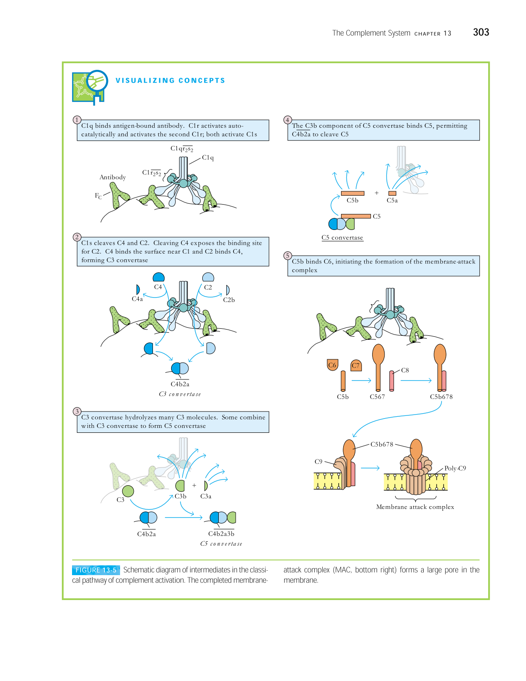

Slide 23
2. Alternate pathway:
Components of the Alternate Pathway
Native component | Active component(s) | Function(s)
C3 | C3a | Mediates inflammation; anaphylatoxin.
 | C3b | Binds cell surfaces for opsonization and activation of alternate pathway.
Factor B | B | Binds membrane bound C3b. Cleaved by Factor D.
 | Ba | Unknown.
 | Bb | Cleaved form stabilized by P produces C3 convertase.
Factor D | D | Cleaves Factor B when bound to C3b.
Properdin | P | Binds and stabilizes membrane bound C3bBb.

Slide 24
2. Alternate pathway:
The Alternative Pathway is Antibody-Independent pathway
The alternative pathway is a component of the innate immune system.
This major pathway of complement activation involves four serum proteins: C3, factor B, factor D, and properdin.
The alternative pathway is initiated in most cases by cell-surface constituents that are foreign to the host.
In the alternative pathway, serum C3, which contains an unstable thioester bond, is subject to slow spontaneous hydrolysis to yield C3a and C3b.
The membranes of most mammalian cells have high levels of sialic acid, which contributes to the rapid inactivation of bound C3b molecules on host cells; consequently this binding rarely leads to further reactions on the host cell membrane.

Slide 25
The C3b present on the surface of the foreign cells can bind another serum protein called factor B to form a complex stabilized by Mg⁺².
Binding to C3b exposes a site on factor B that serves as the substrate for an enzymatically active serum protein called factor D.
Factor D cleaves the C3b-bound factor B, releasing a small fragment (Ba) that diffuses away and generating C3bBb
The C3bBb complex has C3 convertase activity and thus is analogous to the C4b2a complex in the classical pathway.
The C3 convertase activity of C3bBb has a half-life of only 5 minutes unless the serum protein properdin binds to it, stabilizing it and extending the half-life of this convertase activity to 30 minutes.
The C3 convertase activity of C3bBb generates the C3bBb3b complex, which exhibits C5 convertase activity, analogous to the C4b2a3b complex in the classical pathway.

Slide 26
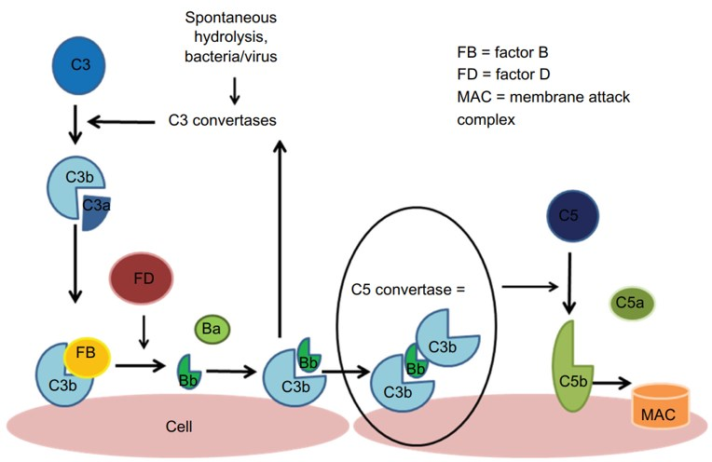
The alternative pathway is triggered by the hydrolysis of C3 which forms C3 and C3b. C3b becomes bound to the cell surface and is then able to interact with factor B, which is cleaved by factor D, creating the Bb fragment which binds to other surface-bound C3b molecules to form C3bBb; the C3 convertase of the alternative pathway triggers an amplification loop, with further hydrolysis of C3. Ultimately, there is further production of C3b which joins with C3 convertase to form C5 convertase which cleaves C5 to C5a and C5b, and this leads to formation of an membrane attack complex.

Slide 27
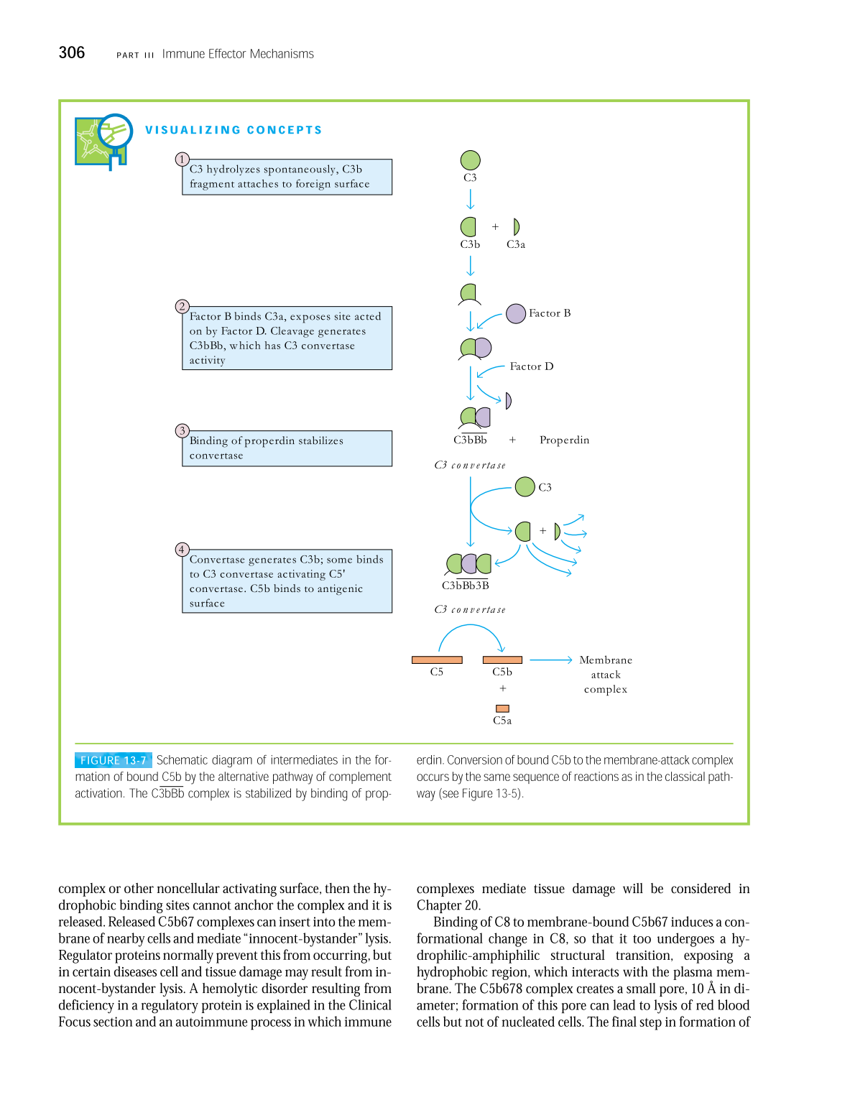

Slide 28
3. Mannan binding lectin (MBL) pathway:
Lectins are proteins that recognize and bind to specific carbohydrate targets.
The lectin pathway, like the alternative pathway, does not depend on antibody for its activation. However, the mechanism is more like that of the classical pathway, because after initiation, it proceeds, through the action of C4 and C2, to produce a C5 convertase.
The lectin pathway is activated by the binding of mannose-binding lectin (MBL) to mannose residues on glycoproteins or carbohydrates on the surface of microorganisms including certain Salmonella, Listeria, and Neisseria strains, as well as Cryptococcus neoformans and Candida albicans.

Slide 29
MBL is an acute phase protein produced in inflammatory responses. Its function in the complement pathway is similar to that of C1q, which it resembles in structure.
After MBL binds to the surface of a cell or pathogen, MBL-associated serine proteases, MASP-1 and MASP-2, bind to MBL.
The active complex formed by this association causes cleavage and activation of C4 and C2. The MASP-1 and-2 proteins have structural similarity to C1r and C1s and mimic their activities.
This means of activating the C2–C4 components to form a C5 convertase without need for specific antibody binding represents an important innate defense mechanism comparable to the alternative pathway, but utilizing the elements of the classical pathway except for the C1 proteins.

Slide 30
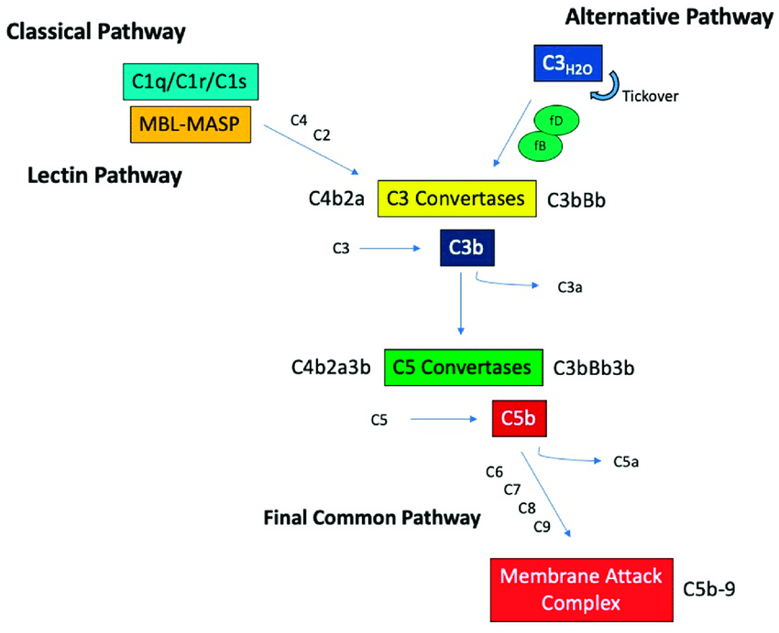
3. Mannan binding lectin (MBL) pathway:

Slide 31
Components of the Membrane-Attack Complex
Native component | Active component(s) | Function(s)
C5 | C5a | Mediates inflammation; anaphylatoxin, chemotaxin.
 | C5b | Initiates assembly of the membrane-attack complex (MAC).
C6 | C6 | Binds C5b, forms acceptor for C7.
C7 | C7 | Binds C5b6, inserts into membrane, forms acceptor for C8.
C8 | C8 | Binds C5b67, initiates C9 polymerization.
C9 | C9n | Polymerizes around C5b678 to form channel that causes cell lysis.

Slide 32
Steps in formation of MAC:
C5 convertase (classical or alternative) cleaves C5 into C5a (soluble, anaphylotoxin) and C5b (membrane bound).
C5b binds C6, forming C5b6 and this binds C7 to form C5b67. C7 inserts into the membrane. Up to this point, the complement components have bound to surface of membrane.
C8 binds to this complex (C5b678), also inserting into membrane.
There is a stepwise addition of up to fourteen C9 molecules (C5b-9), resulting in the formation of a pore in the membrane. This “hole” results in lysis of cell.

Slide 33
Overview of the complement activation pathways

Slide 34
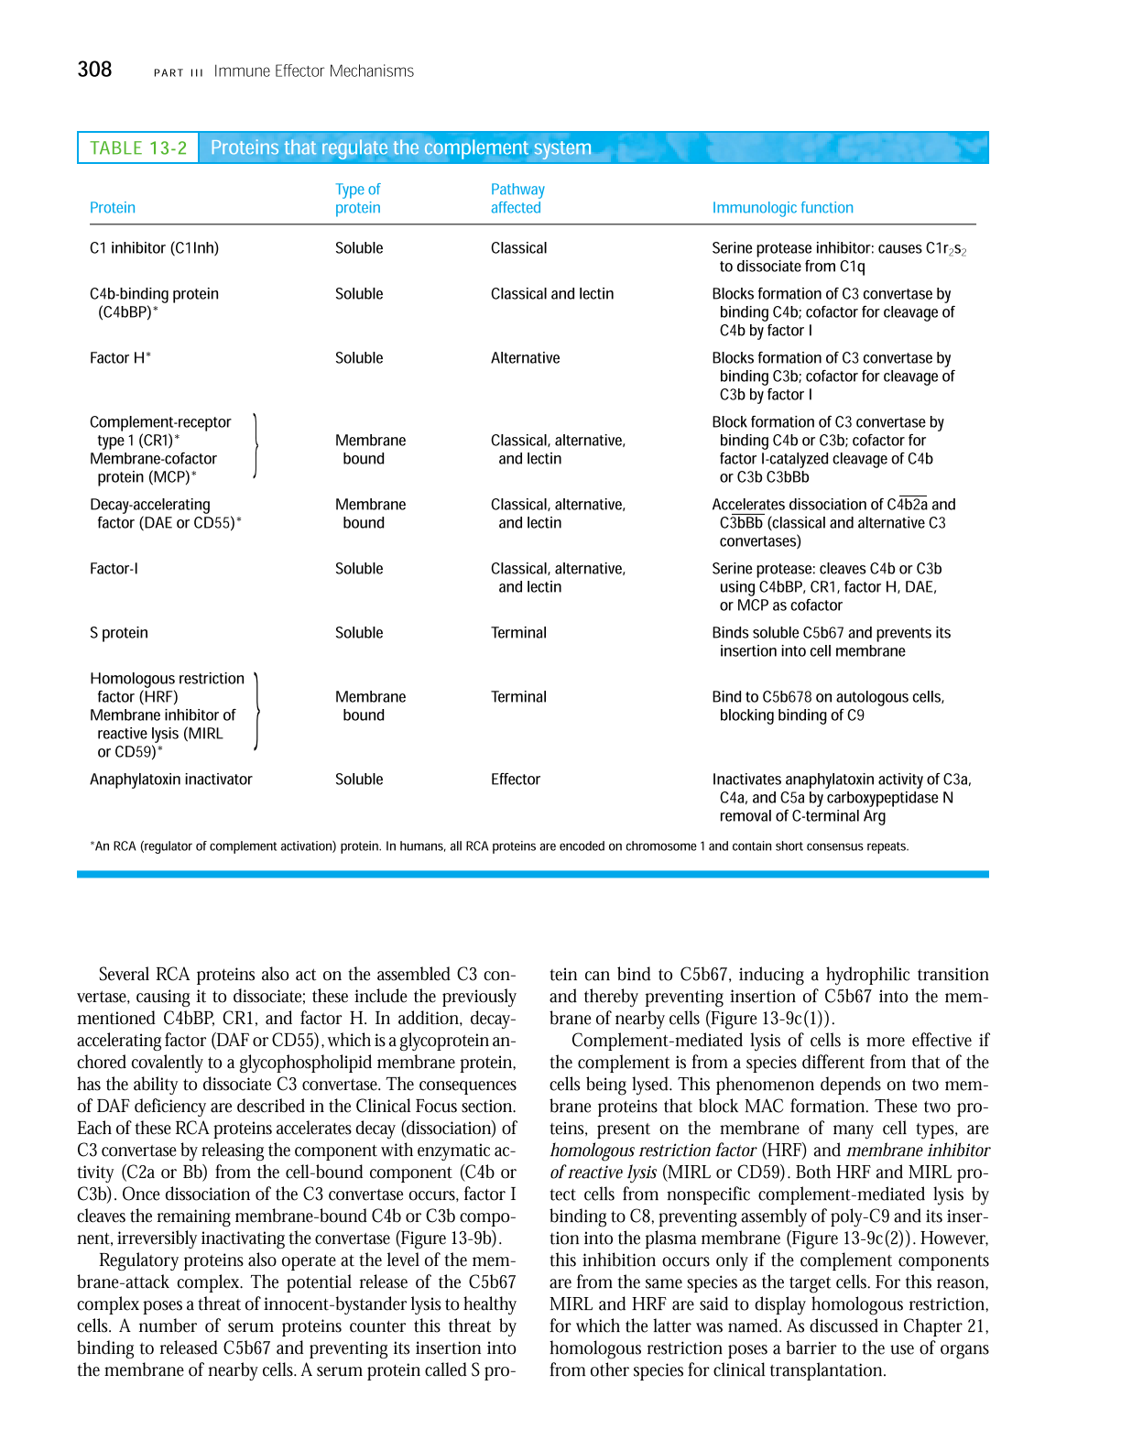

Slide 35
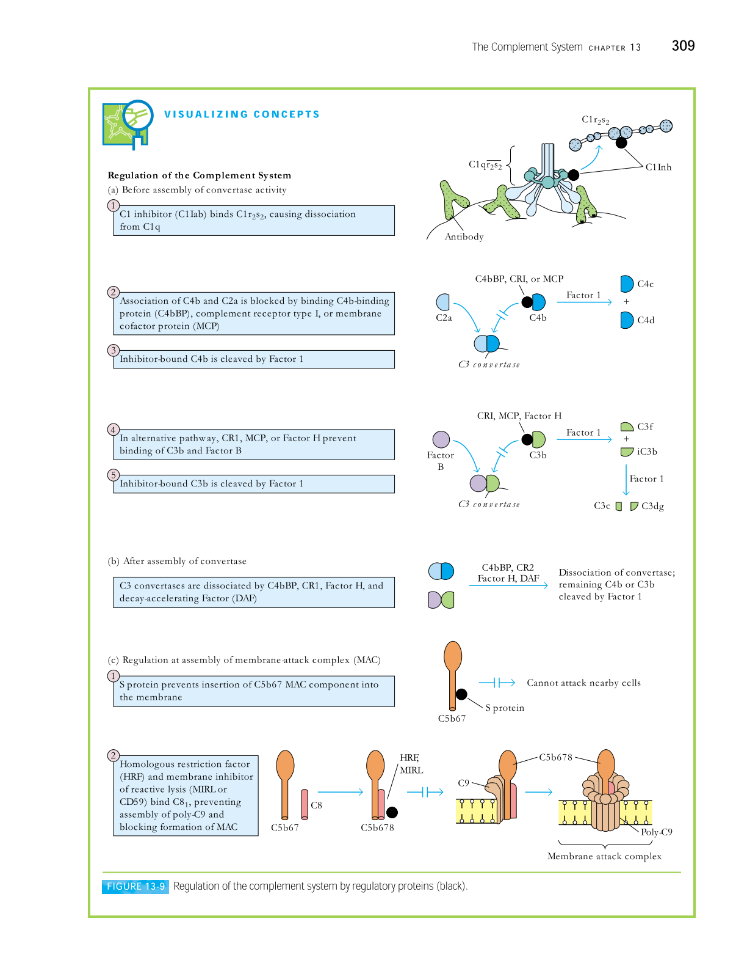

Slide 37
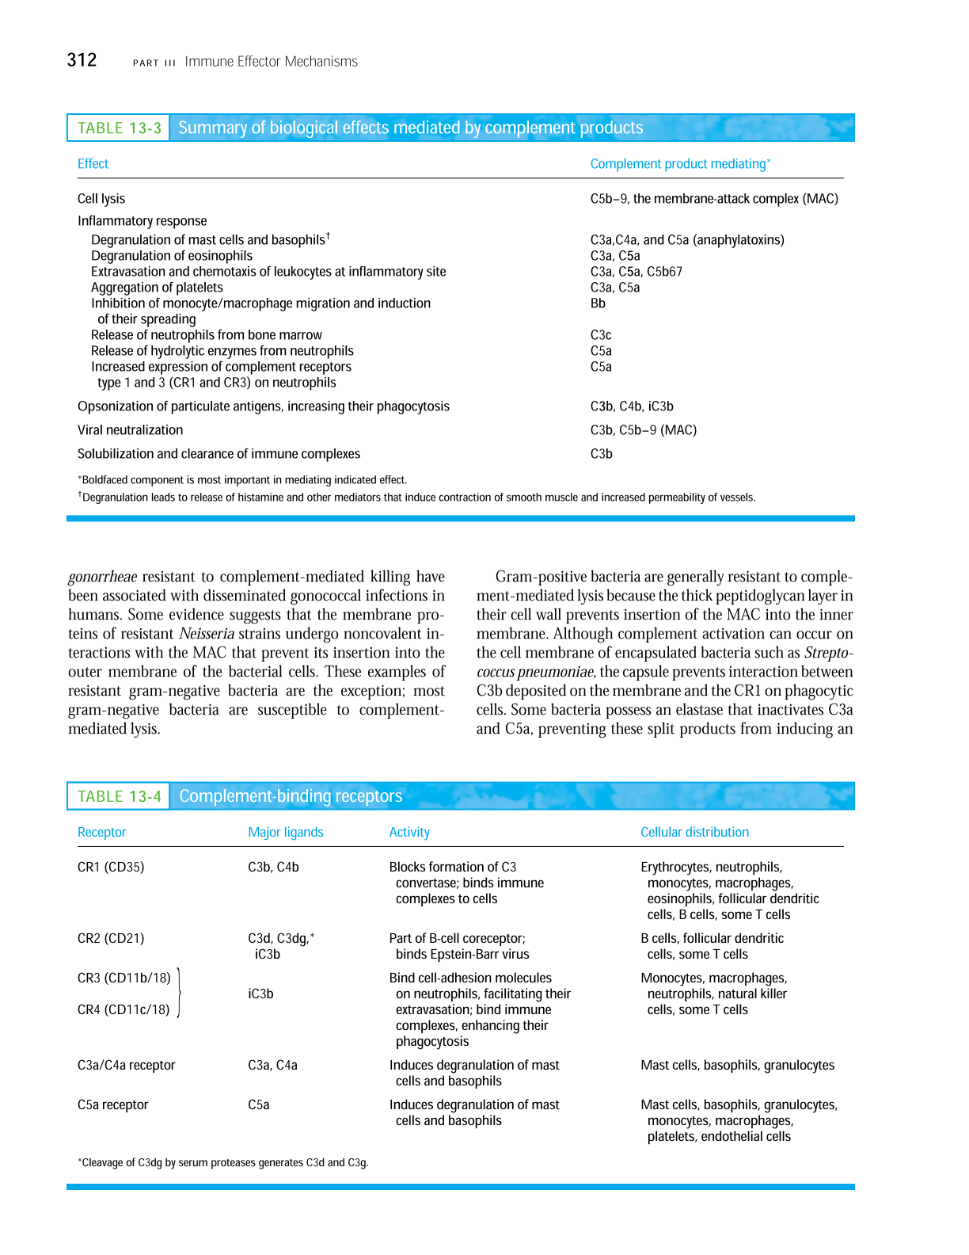

Slide 39
Functions of complement system:
The functions of complement include:
Opsonization and phagocytosis- C3b, bound to immune complex or coated on the surface of pathogen, activate phagocytic cells. These proteins bind to specific receptors on the phagocytic cells to get engulfed.
Cell lysis- Membrane attack complex formed by C5b6789 components ruptures the microbial cell surface which kills the cell.
Chemotaxis-Complement fragments attract neutrophils and macrophages to the area where the antigen is present. These cell surfaces have receptors for complements, like C5a, C3a, thus, run towards the site of inflammation, i.e. chemotaxis.

Slide 40
Activation of mast cells and basophils and enhancement of inflammation-
The proteolytic complement fragments, C5a, C4a, and C3a induce acute inflammation by activating mast cells and neutrophils.
All three peptides bind to mast cells and induce degranulation, with the release of vasoactive mediators such as histamine.
These peptides are also called anaphylatoxins because the mast cell reactions they trigger are characteristic of anaphylaxis.
Binding to specific complement receptors on cells of the immune system, they trigger specific cell functions, inflammation, and secretion of immunoregulatory molecules.

Slide 41
Production of antibodies- B cells have receptor for C3b. When C3b binds to B-cell, it secretes more antibodies. Thus C3b is also an antibody producing amplifiers which converts it into an effective defense mechanism to destroy invading microorganism.
Immune clearance- The complement system removes immune complexes from the circulation and deposits them in the spleen and liver. Thus it acts as anti-inflammatory function. Complement proteins promote the solubilization of these complexes and their clearance by phagocytes.

Slide 42
Complement Deficiencies
Canine C3 Deficiency
Heterozygous animals are clinically normal.
The homozygous deficient animals have lower lgG level then normal and their ability to make against defined antigens is reduced.
The dogs tend to make more IgM and less IgG. They experience recurrent sepsis, pneumonia, pyometra and wound infections.
Some affected dogs develop amyloidosis and many immune-complex mediated kidney disease.

Slide 43
Porcine factor H deficiency
Factor H is a critical component of the alternative pathway.
It normally inactivates C3b as soon as so prevents excessive alternative pathway.
If an animal fails to make factor H, then C3b will be generated in an uncontrolled fashion.
Factor H deficiency has been identified as an autosomal recessive trait in Yorkshire pigs. Nephritic piglets are almost totally deficient in factor H.

Slide 44
Thank You
Dr. Sandeep Kumar Sharma, BVSc & AH, MVSc and PhD
Assistant Professor, PGIVER
drsharmask01@hotmail.com
Mob. 9414775879

